Slide 1

Module 1 - Class 2.3
Understanding the URL of the Waze GeoRSS API

Slide 2
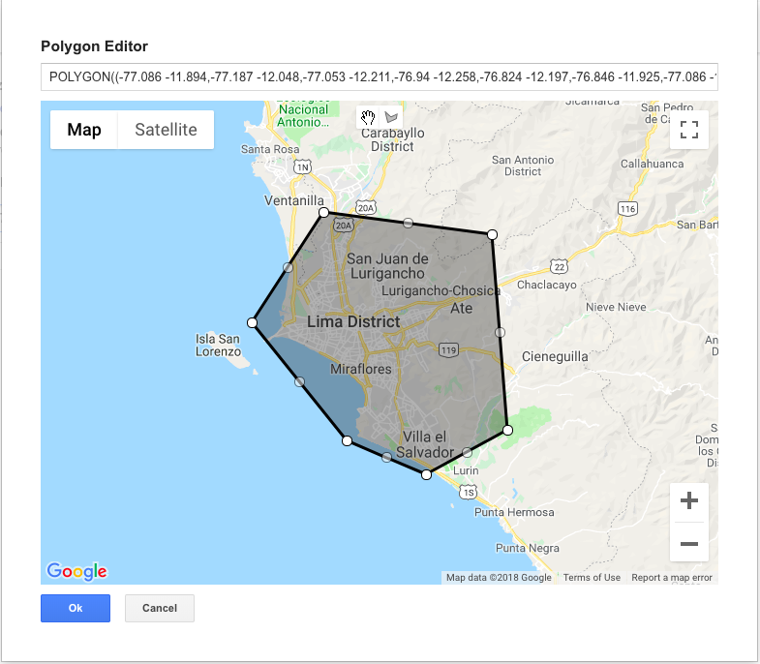
An example, Lima, Peru

Slide 3
The URL
https://<something-confidential>?format=JSON&acotu=true&irmie=true&types=traffic%2Calerts%2Cirregularities&tk=ccp_partner&ccp_partner_name=Organization+Partner+Name&polygon=-46.774,-23.482;-46.77,-23.597;-46.608,-23.715;-46.527,-23.659;-46.57,-23.581;-46.412,-23.567;-46.449,-23.461;-46.774,-23.482

Slide 4
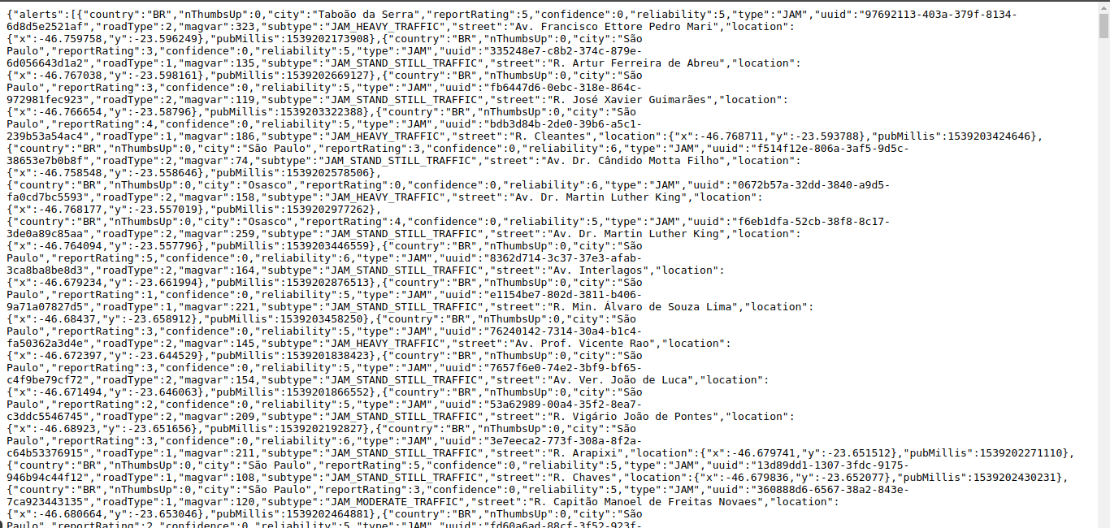
The Waze GeoRSS API

Slide 5
https://<something-confidential>?
format=JSON&
acotu=true&
irmie=true&
types=traffic%2Calerts%2Cirregularities&
tk=ccp_partner&
ccp_partner_name=Organization+Partner+Name&
polygon=-46.774,-23.482;
-46.77,-23.597;
-46.608,-23.715;
-46.527,-23.659;
-46.57,-23.581;
-46.412,-23.567;
-46.449,-23.461;
-46.774,-23.482
Breaking the URL

Slide 6
https://<something-confidential>?
format=JSON&
acotu=true&
irmie=true&
types=traffic%2Calerts%2Cirregularities&
tk=ccp_partner&
ccp_partner_name=Organization+Partner+Name&
polygon=-46.774,-23.482;
-46.77,-23.597;
-46.608,-23.715;
-46.527,-23.659;
-46.57,-23.581;
-46.412,-23.567;
-46.449,-23.461;
-46.774,-23.482
https://<something-confidential>
Description
GeoRSS Waze API address

Slide 7
https://<something-confidential>
format=JSON&
acotu=true&
irmie=true&
types=traffic%2Calerts%2Cirregularities&
tk=ccp_partner&
ccp_partner_name=Organization+Partner+Name&
polygon=-46.774,-23.482;
-46.77,-23.597;
-46.608,-23.715;
-46.527,-23.659;
-46.57,-23.581;
-46.412,-23.567;
-46.449,-23.461;
-46.774,-23.482
format
Description
data format option.
only JSON and XML (one or another) is accept

Slide 8
https://<something-confidential>
format=JSON&
acotu=true&
irmie=true&
types=traffic%2Calerts%2Cirregularities&
tk=ccp_partner&
ccp_partner_name=Organization+Partner+Name&
polygon=-46.774,-23.482;
-46.77,-23.597;
-46.608,-23.715;
-46.527,-23.659;
-46.57,-23.581;
-46.412,-23.567;
-46.449,-23.461;
-46.774,-23.482
acotu
Description
receives the number of thumbs up by users on alerts
it is optional and only accept true or false

Slide 9
https://<something-confidential>
format=JSON&
acotu=true&
irmie=true&
types=traffic%2Calerts%2Cirregularities&
tk=ccp_partner&
ccp_partner_name=Organization+Partner+Name&
polygon=-46.774,-23.482;
-46.77,-23.597;
-46.608,-23.715;
-46.527,-23.659;
-46.57,-23.581;
-46.412,-23.567;
-46.449,-23.461;
-46.774,-23.482
irmie
Description
receives irregularities by users
it only accept True or False

Slide 10
https://<something-confidential>
format=JSON&
acotu=true&
irmie=true&
types=traffic%2Calerts%2Cirregularities&
tk=ccp_partner&
ccp_partner_name=Organization+Partner+Name&
polygon=-46.774,-23.482;
-46.77,-23.597;
-46.608,-23.715;
-46.527,-23.659;
-46.57,-23.581;
-46.412,-23.567;
-46.449,-23.461;
-46.774,-23.482
types
Description
choose any of the waze data types
the accepted inputs are traffic, alerts or irregularities and at least one is required

Slide 11
https://<something-confidential>
format=JSON&
acotu=true&
irmie=true&
types=traffic%2Calerts%2Cirregularities&
tk=ccp_partner&
ccp_partner_name=Organization+Partner+Name&
polygon=-46.774,-23.482;
-46.77,-23.597;
-46.608,-23.715;
-46.527,-23.659;
-46.57,-23.581;
-46.412,-23.567;
-46.449,-23.461;
-46.774,-23.482
tk
Description
CCP organization token

Slide 12
https://<something-confidential>
format=JSON&
acotu=true&
irmie=true&
types=traffic%2Calerts%2Cirregularities&
tk=ccp_partner&
ccp_partner_name=Organization+Partner+Name&
polygon=-46.774,-23.482;
-46.77,-23.597;
-46.608,-23.715;
-46.527,-23.659;
-46.57,-23.581;
-46.412,-23.567;
-46.449,-23.461;
-46.774,-23.482
ccp_partner_name
Description
CCP organization partner name

Slide 13
https://<something-confidential>
format=JSON&
acotu=true&
irmie=true&
types=traffic%2Calerts%2Cirregularities&
tk=ccp_partner&
ccp_partner_name=Organization+Partner+Name&
polygon=-46.774,-23.482;
-46.77,-23.597;
-46.608,-23.715;
-46.527,-23.659;
-46.57,-23.581;
-46.412,-23.567;
-46.449,-23.461;
-46.774,-23.482
polygon
Description
the polygon of the city where the data comes from
the input format is
long-value,lat-value;long-value,lat-value;...;long-value,lat-value

Slide 14
See you in the next video!

